Slide 1



By: Waleed, Nathaly, Jacob and Ryan

Slide 2
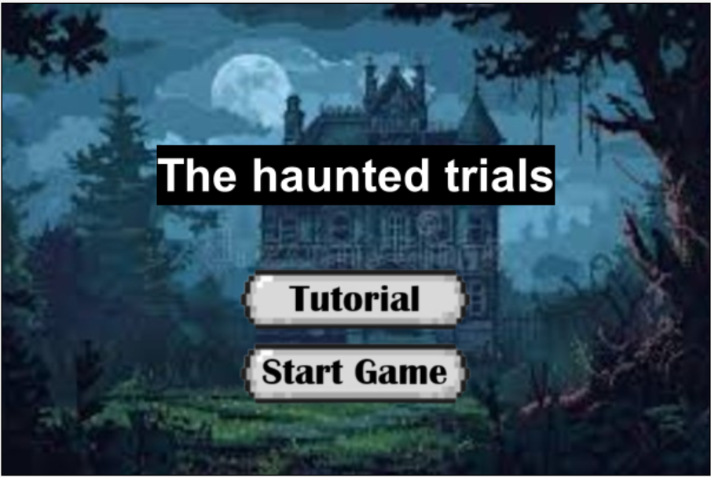
This is the title screen. You have two options. You can choose to go straight into the game or go to the tutorial first (which is very recommended).

Slide 3
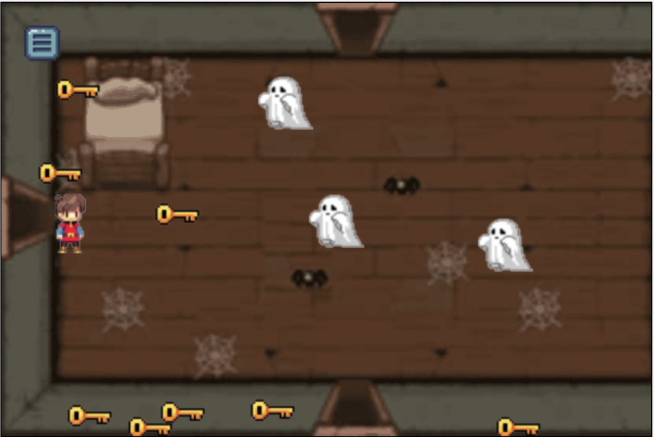
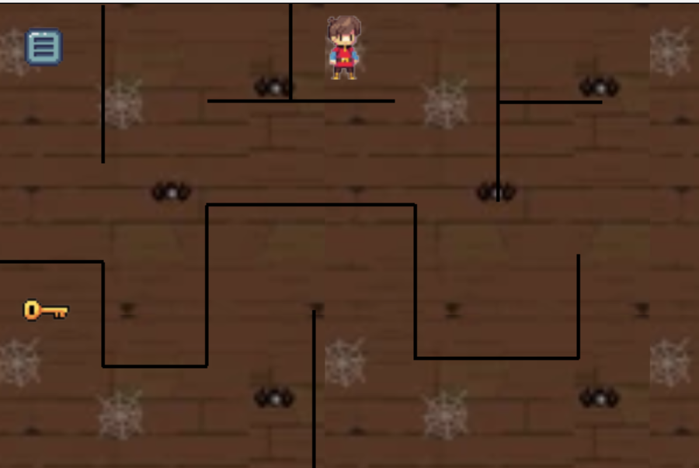
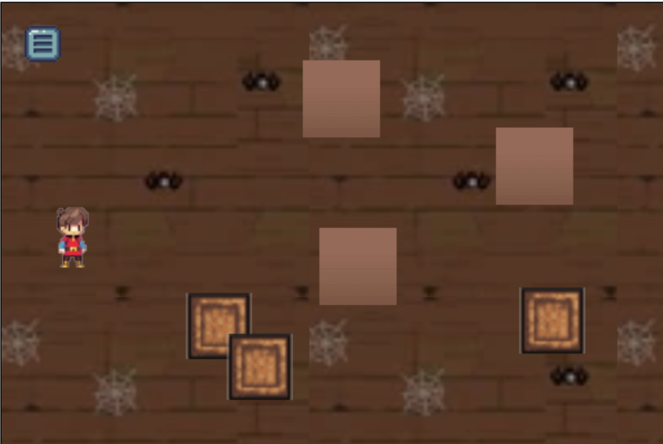
Level 3 which requires you to push the 3 boxes to the spot
This is the first level, you must get all 6* keys 2 times
Level 2 which is a simple maze.
* Changed compared to photo *

Slide 4
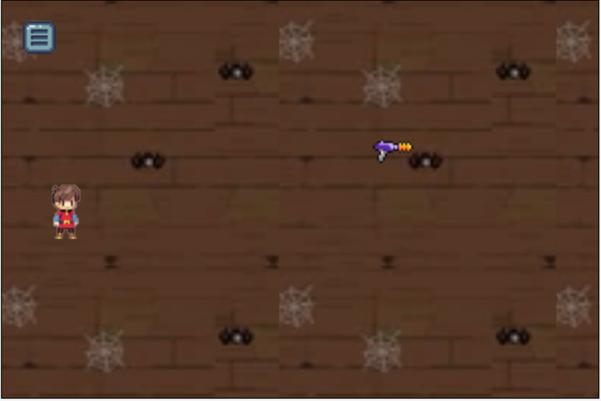
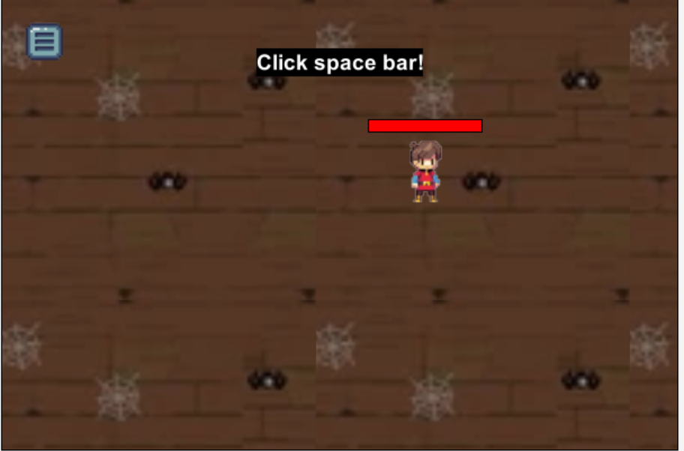
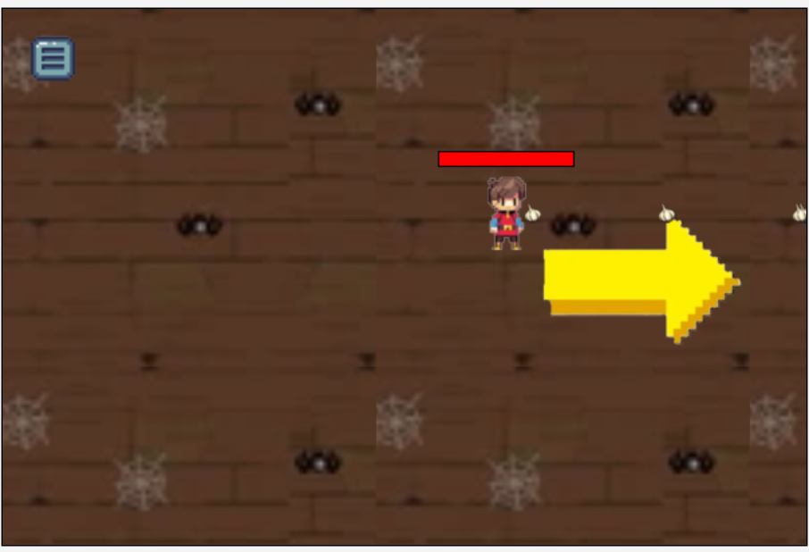
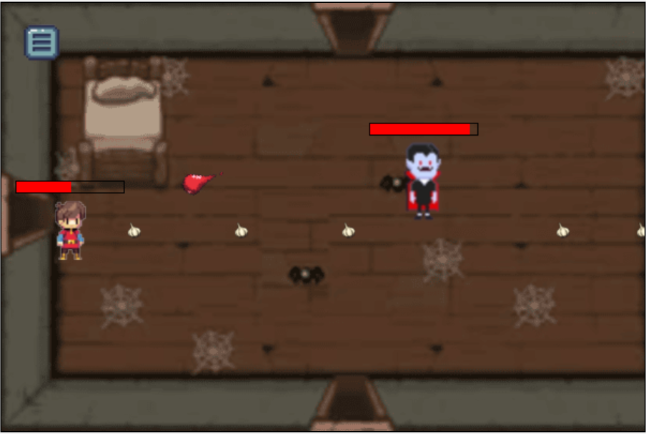
The mini tutorial that leads into the final boss.

Slide 5
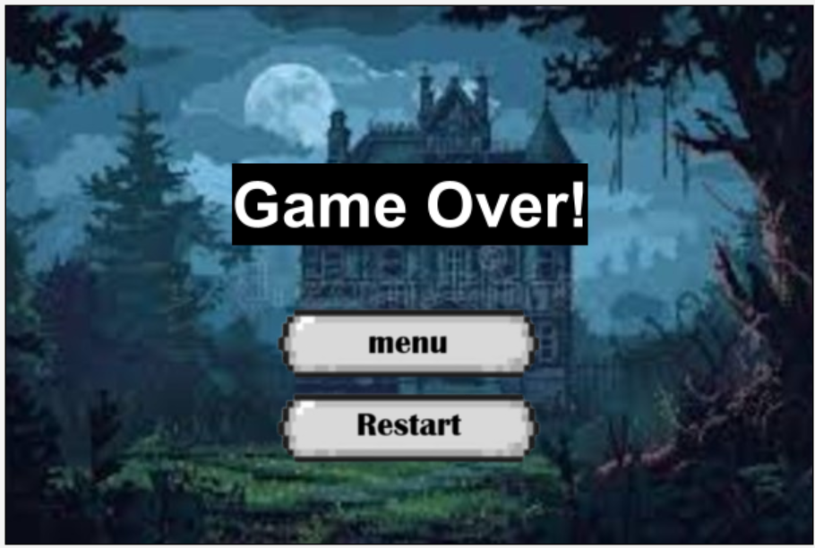
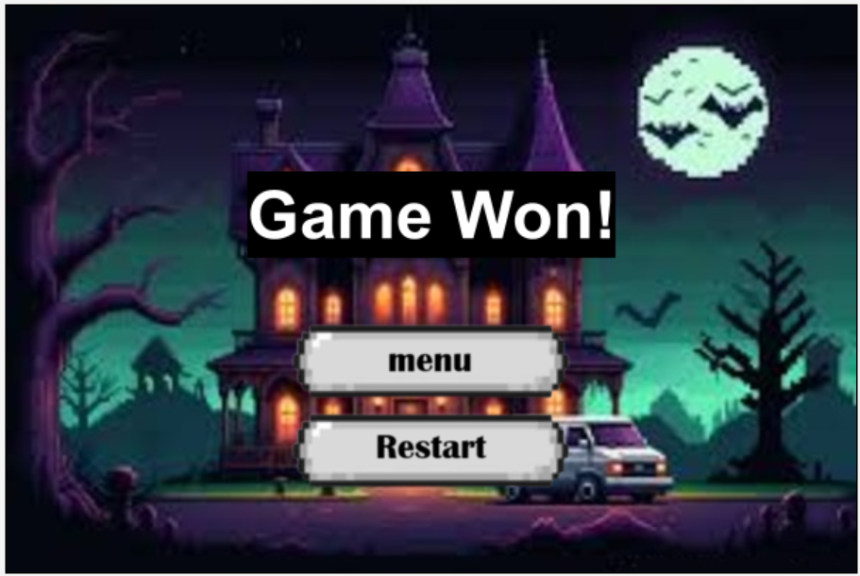
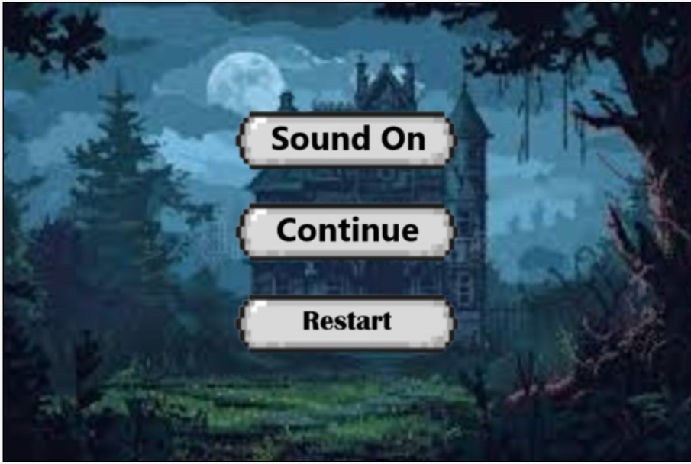

Slide 6
CYMBAL
PRODUCT OVERVIEW
Thank
you.

